Slide 1

Cloud Architectures and Design Strategies
Introduction to Cloud Computing

Slide 2
Lecture Objectives
Understand the components of cloud architecture.
Learn about Regions, Availability Zones, and Resource Groups.
Explore Subscriptions and Management Groups.
Discover the role of Azure Resource Manager in cloud design.

Slide 3
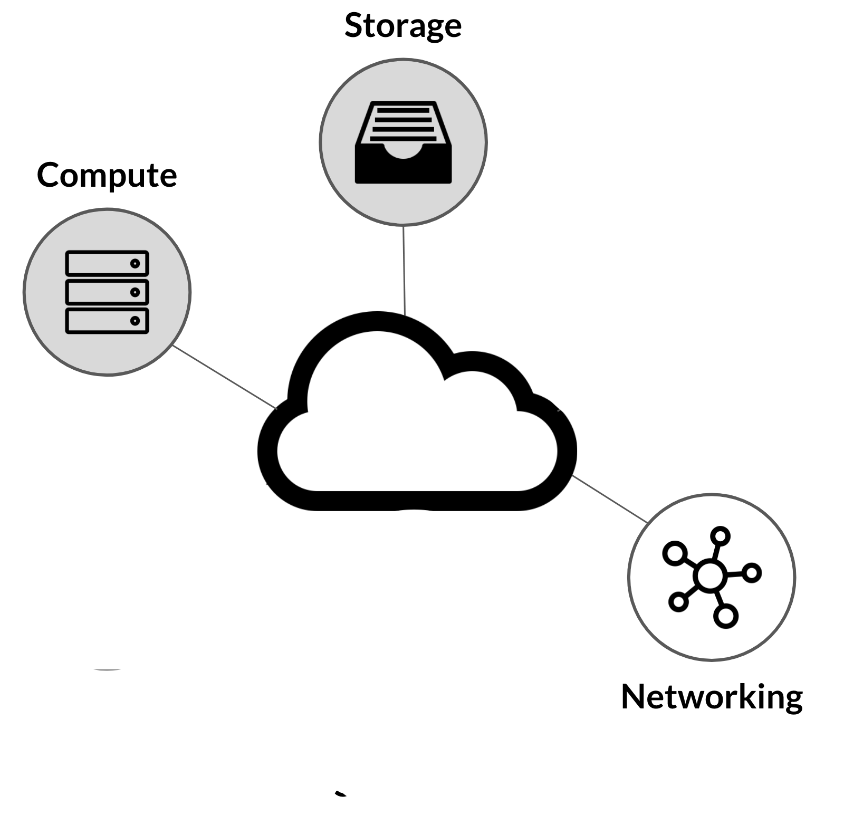
Cloud Architectural Components
Compute: Virtual Machines, Containers, Serverless Functions.
Storage: Object Storage, File Storage, Block Storage.
Networking: Virtual Networks, Load Balancers, Gateways.
Monitoring: Tools like Azure Monitor, AWS CloudWatch.
Security: Identity and Access Management, Firewalls.

Slide 4
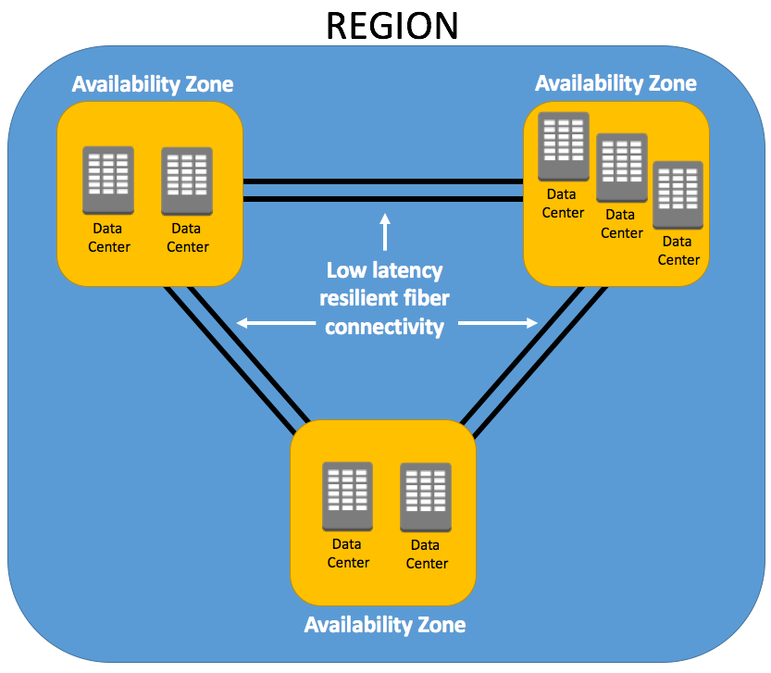
Cloud and Cloud Computing
Regions: Geographical areas with multiple data centers.
Availability Zones: Isolated locations within a region to enhance fault tolerance.
Data residency compliance achieved through regions.
High availability through zone redundancy.

Slide 5
Resource Groups
Logical containers for managing cloud resources.
Enable easier resource tracking and management.
Examples: Grouping VMs, databases, and networks for a single application.

Slide 6
Subscriptions and Management Groups
Subscriptions: Billing containers for Azure resources.
Enable resource usage tracking and cost management.
Management Groups: Hierarchical structure to manage multiple subscriptions.
Apply policies and access controls at a high level.

Slide 7
Azure Resource Manager (ARM)
Centralized tool for managing Azure resources.
Provides declarative templates for consistent deployments.
Role-Based Access Control (RBAC) ensures secure access.
Enables tagging for resource categorization.

Slide 8
Benefits of Using ARM
Simplifies resource management through templates.
Ensures consistency across deployments.
Enhances security with RBAC.
Tracks costs and performance with tagging.

Slide 9
Summary
Cloud architecture includes compute, storage, networking, and monitoring.
Regions and Availability Zones ensure high availability and fault tolerance.
Resource Groups, Subscriptions, and Management Groups simplify resource organization.
Azure Resource Manager (ARM) enhances deployment consistency and security.

Slide 10
Questions?

